Slide 1
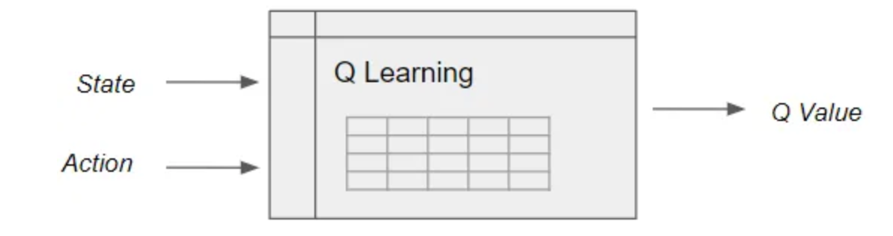
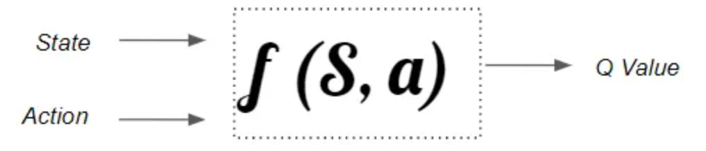
Q-Learning

Slide 2
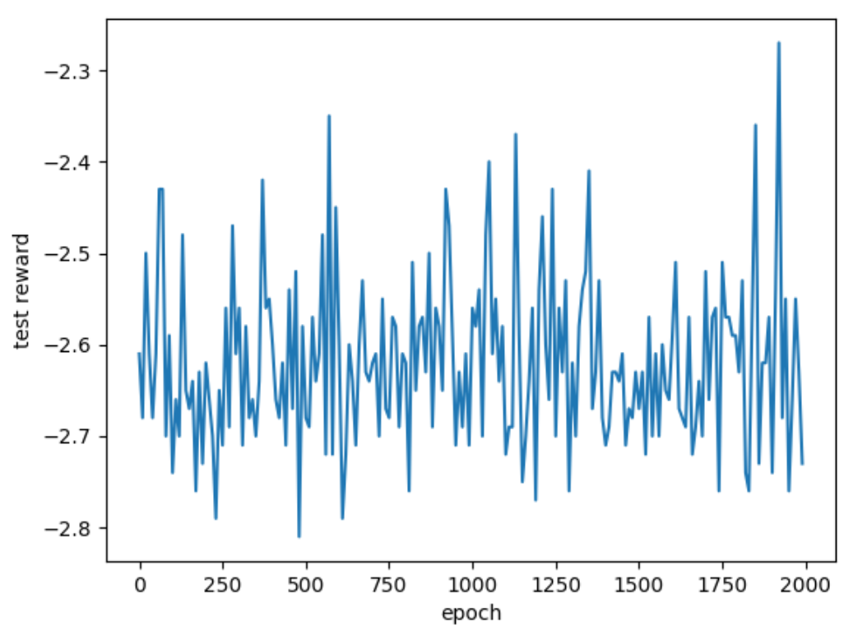
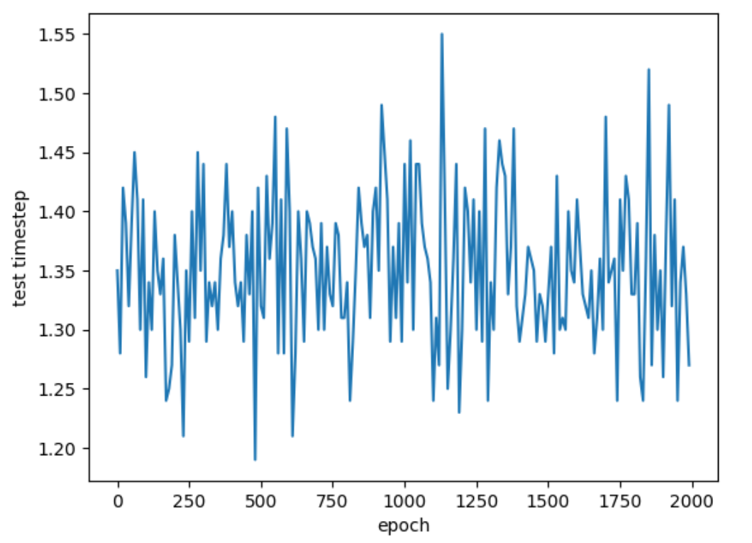
Reinforcement Learning for Signal Process

Slide 3
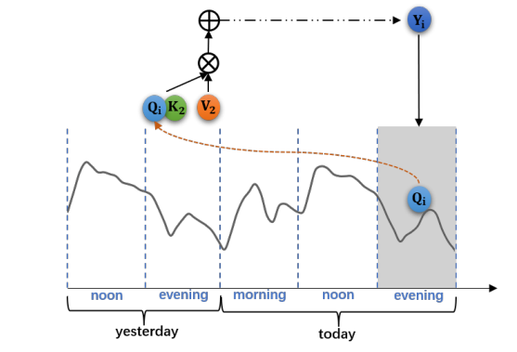
A Time Series is Worth 64 Words: Long-term Forecasting with Transformers (2023 ICLR)
Patching
Divide input time series data into overlapped or non-overlapped patches. In NLP task, data is point-level (words), in time series task, data is subseries-level (heart-beat)
Reduction on time and space complexity
Prepare for self-supervised representation learning

Slide 4
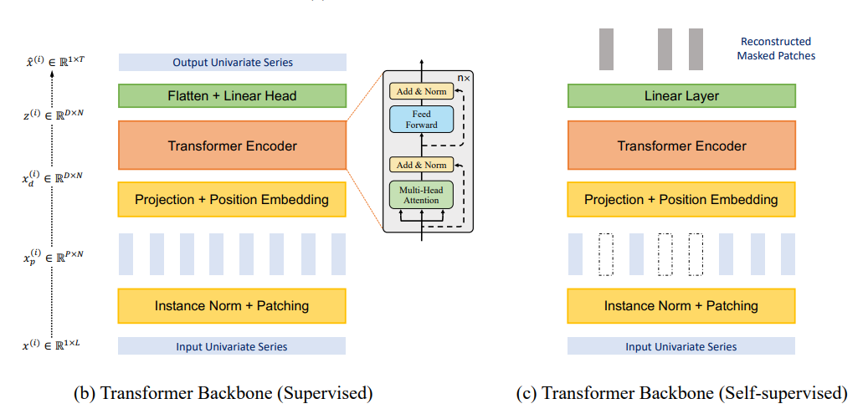
A Time Series is Worth 64 Words: Long-term Forecasting with Transformers (2023 ICLR)
Self-supervised representation learning

Slide 5

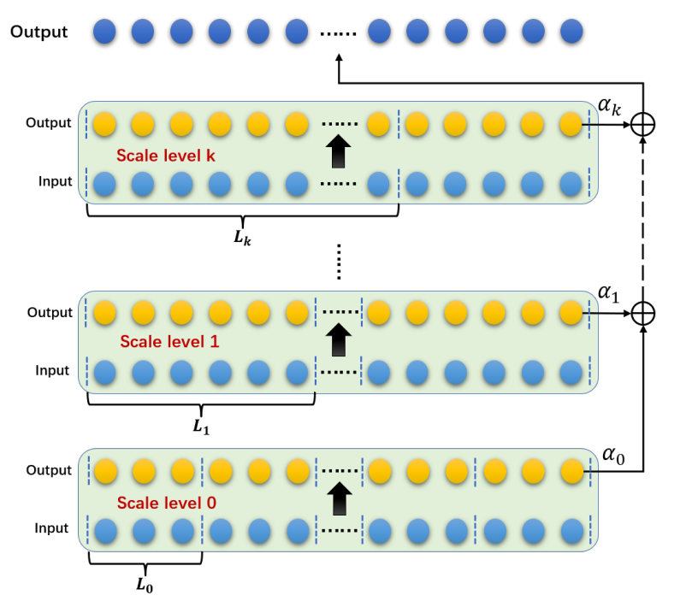
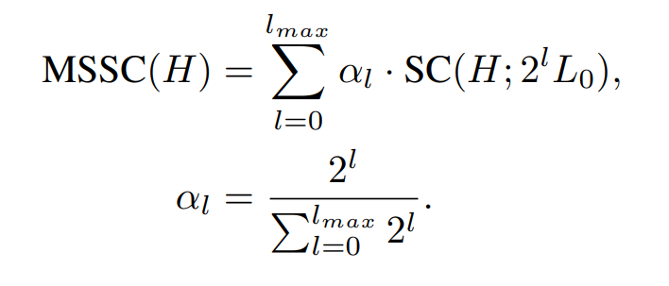
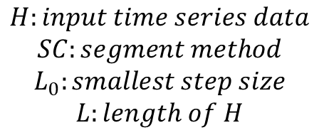
How to choose patching step
Preformer: Predictive Transformer with Multi-Scale Segment-Correlation for Long-Term Forecasting
Multi-Scale Segment-Correlation: fusing the output of multiple Segment-Correlation with different step.
$$H:input time series data$$
$$SC:segment method$$
$$L_{0}:smallest step size$$
$$L:length of H$$

Slide 6
THANKS!

